Slide 1

Red Hat JBoss and Hortonworks
Proof of Technology

Slide 2
Use Case 1 – Sentiment Analysis and Sales Analysis with Hadoop and MySQL

Slide 3

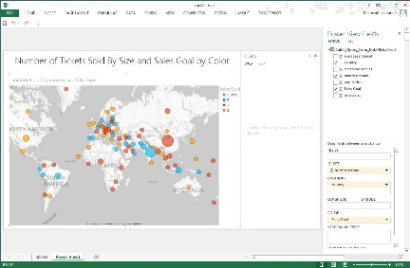


Use Case 1 - Overview
Excel Powerview and DV Dashboard to analyze the aggregated data
Objective:
-Determine if sentiment data from the first week of the Iron Man 3 movie is a predictor of sales
Problem:
-Cannot utilize social data and sentiment analysis with sales management system
Solution:
-Leverage JBoss Data Virtualization to mashup Sentiment analysis data with ticket and merchandise sales data on MySQL into a single view of the data.
JBoss Data Virtualization
Consume
Compose
Connect
Hive
SOURCE 1: Hive/Hadoop contains twitter data including sentiment
SOURCE 2: MySQL data that includes ticket and merchandise sales

Slide 4


Use Case 1 – Architecture
APPLICATIONS
Business Analytics
Custom Applications
Packaged
Applications
DATA SYSTEM
VIRTUAL DATA MART
TRADITIONAL REPOSITORIES
RDBMS
EDW
MPP
Scenario : Accessing data from Hadoop and a relational store
Sentiment and Sales Analysis with Hadoop and MySQL

Slide 5
Use Case 1 - Resources
GUIDE
How to guide: https://github.com/DataVirtualizationByExample/HortonworksUseCase1
Tutorial: http://hortonworks.com/hadoop-tutorial/evolving-data-stratagic-asset-using-hdp-red-hat-jboss-data-virtualization/
VIDEOS:
http://vimeo.com/user16928011/hortonworksusecase1short
http://vimeo.com/user16928011/hortonworksusecase2short
SOURCE:
https://github.com/DataVirtualizationByExample/HortonworksUseCase1

Slide 6
Use Case 2 – Federated Hadoop with security

Slide 7
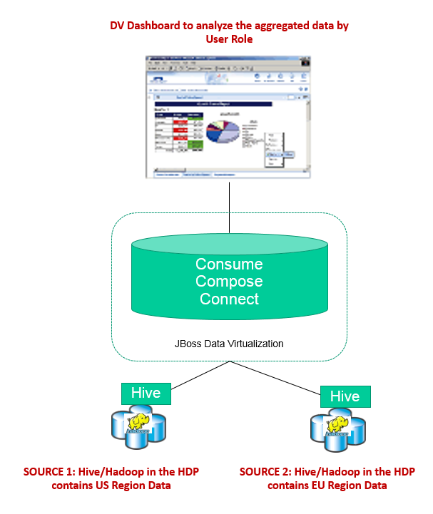
Use Case 2 - Overview
Objective:
-Secure data according to Role for row level security and Column Masking
Problem:
-Cannot hide region data from region specific users
Solution:
-Leverage JBoss Data Virtualization to provide Row Level Security and Masking of columns

Slide 8
Use Case 2 - Architecture
APPLICATIONS
Business Analytics
Custom Applications
Packaged
Applications
DATA SYSTEM
VIRTUAL DATA MART
Scenario : two Hadoop clusters, different location (US & EMEA), two types of dataset for each regions.

Slide 9
Use Case 2 - Resources
GUIDE
How to guide: https://github.com/DataVirtualizationByExample/HortonworksUseCase2
Tutorial: Available soon
VIDEOS:
http://vimeo.com/user16928011/hortonworksusecase2short
http://vimeo.com/user16928011/hortonworksusecase2short
SOURCE:
https://github.com/DataVirtualizationByExample/HortonworksUseCase2

Slide 10
Use Case 3 – Hadoop Datalake

Slide 11
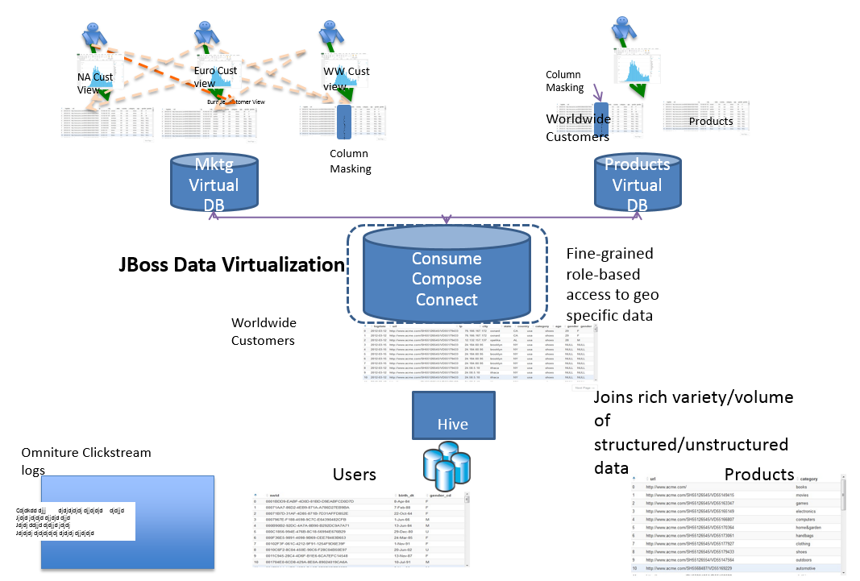
Use Case 3 - Overview
Objective:
–Purpose oriented data views for functional teams over a rich variety of semi-structured and structured data
Problem:
–Data Lakes have large volumes of consolidated clickstream data, product and customer data that need to be constrained for multi-departmental use.
Solution:
–Leverage HDP to mashup Clickstream analysis data with product and customer data on HDP to answer
- Leverage Jboss Data Virt to provide Virtual data marts for each of Marketing and Product teams to …..

Slide 12




Use Case 3 - Architecture
APPLICATIONS
Business Analytics
Custom Applications
Packaged
Applications
DATA SYSTEM
VIRTUAL DATA MART
HDP 2.1
Data Access
Governance & Integration
Operations
Security
Data Management
SOURCES
Existing Sources (CRM, ERP, Clickstream, Logs)
Emerging Sources (Sensor, Sentiment, Geo, Unstructured)

Slide 13
Use Case 3 - Resources
GUIDE
How to guide: https://github.com/DataVirtualizationByExample/HortonworksUseCase3
Tutorial: Available soon
VIDEOS:
http://vimeo.com/user16928011/hortonworksusecase3short
http://vimeo.com/user16928011/hortonworksusecase3short
SOURCE:
https://github.com/DataVirtualizationByExample/HortonworksUseCase3

